Slide 1
Lead Scoring Case Study (Using Logistic Regression)
03/03/2019
Team Members
Shivali Dalmia
Pranav Kanwar
Viren Agarwal
Biju Kumar

Slide 2
Content
Problem Statement
Analysis Methodology
Business Impact
Summary

Slide 3
Problem Statement
X Education sells online courses to industry professionals. The company markets its online course , over website and through referral process. Leads driven through ‘interest shown’ are converted into enrollment.
Currently the company is facing low conversion rate for the leads that have shown interest. By knowing the potential lead – ‘Hot Leads’ – the sales team can focus on the ‘Hot Leads’ enabling better conversion rate.

Slide 4
Analysis Methodology
Data Cleaning
Identify lead score
Data Preparation
Accuracy
Data Standardization
ROC value
Generate PCA
Develop model

Slide 5
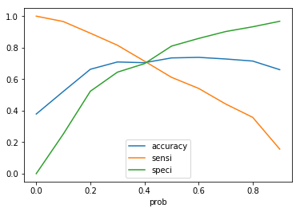
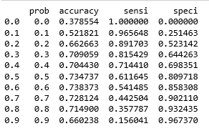
Business Impact (Cutoff Probability)
Tightened Cutoff Probability of 0.5 considered in order to drive improvement

Slide 6
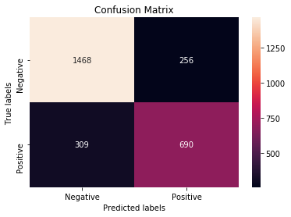


Business Impact (Confusion Matrix)
Precision – Probability that predicated ‘Yes’ is an yes
Precision = 73%
Recall – Probability that predicated ‘Yes’ is an yes
Recall = 69%

Slide 7
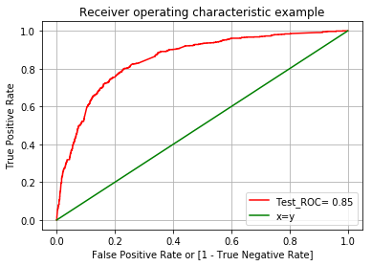


Business Impact (ROC Curve)
ROC Curve (Receiver Operating Characteristic Curve)
It’s a tool for predicting the probability of binary outcome
True Positive Rate(TPR) – Sensitivity
False Positive Rate(TPR) – Specificity

Slide 8
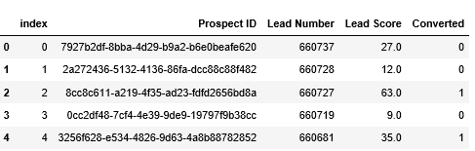
Summary
Sales team could use the lead score to target potential leads.
Reinforce communication channel, to have better conversion of the lead .
Current cutoff score is 50%, but could reduce this further to 40%, to improve the coverage.
Potential Target

Slide 9
Thank you

